Slide 1
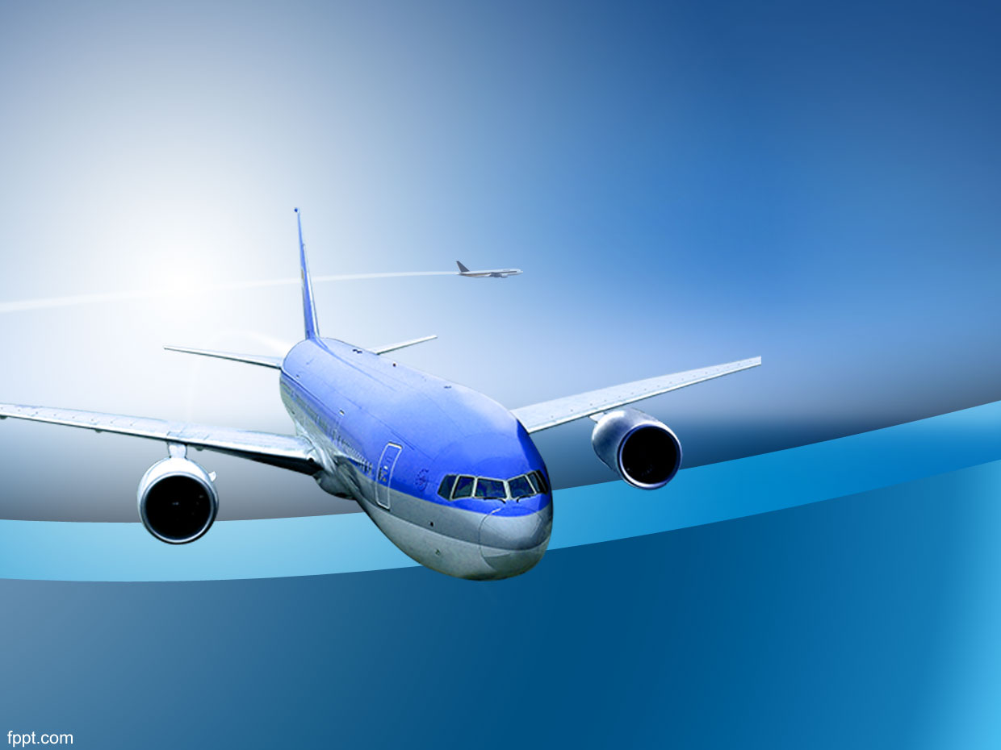
Air the Safest Way to Travel
Christopher Bradway
Bellevue University DSC 640
July 20, 2020

Slide 2
Abstract
Based on current media and social media panic, the perception of aviation safety has come into question. After doing the analysis and research we have created a comparison with vehicle safety, and compiled visual proof to support the level of safety of air travel.

Slide 3
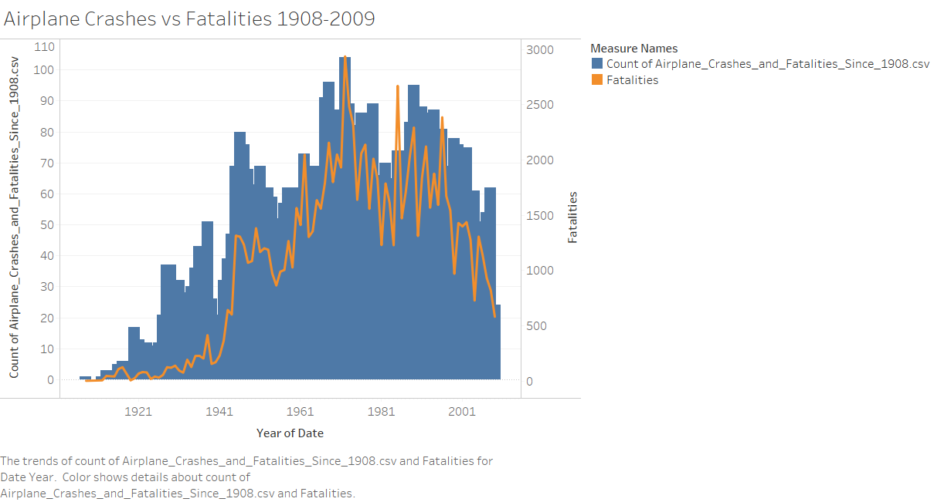
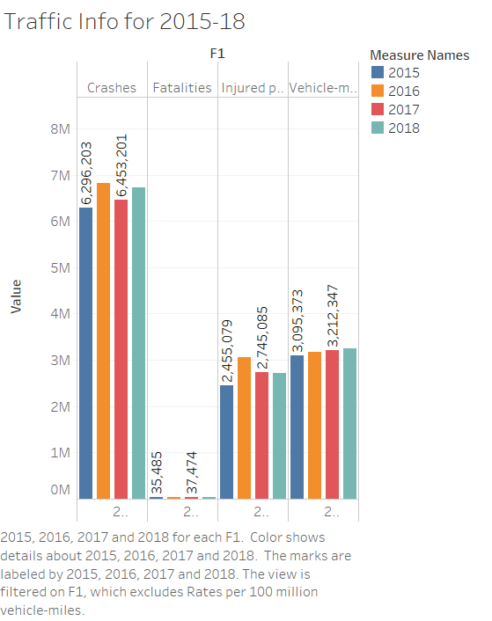
Crashes and Fatalities
Aviation: The trend of crashes and fatalities has been decreasing.
Vehicle: Crashes and fatalities are fairly level.

Slide 4
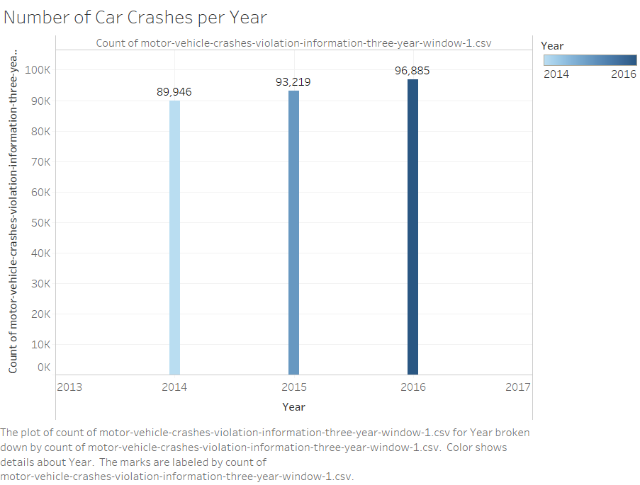
Vehicle Crashes-Violations
In a recent three year period crashes-violations have increased.

Slide 5
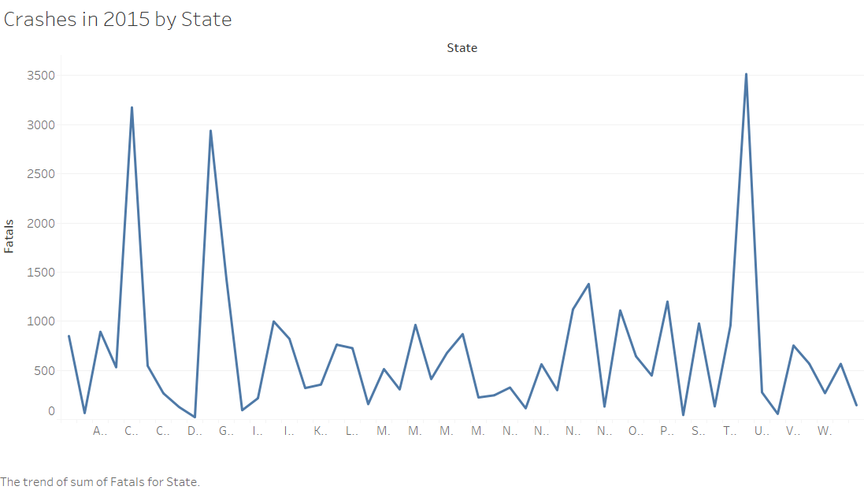
Vehicle Fatalities by State 2015
Most states show more vehicle fatalities per state than total annual fatalities by air travel.

Slide 6
Crash and Fatalities Trends
Vehicle
Slight changes but level
Increase in safety
Little change
Very little increase in miles traveled.

Slide 7
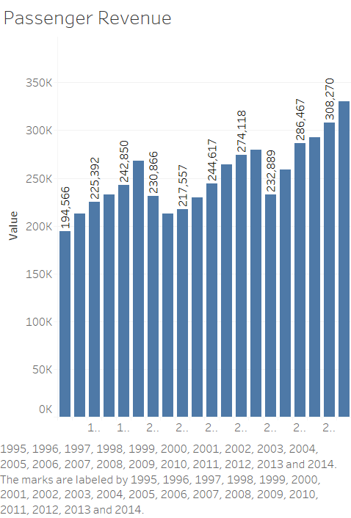
Passenger Revenue
Steady increase since 2010
Not just because of ticket price increase

Slide 8
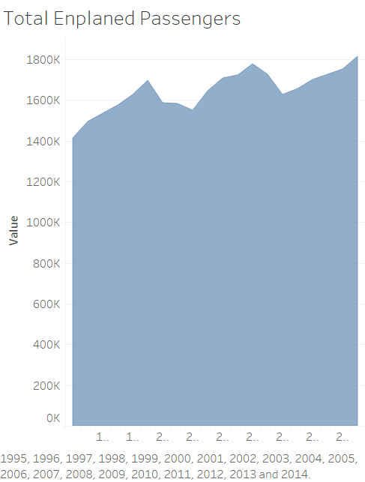
Enplaned Passengers
The graph of enplaned passengers correlates with the revenue.
Shows that the number of people flying since 2010 has been steadily increasing

Slide 9
Crash and Fatalities Trends
Aviation
Since 1989 the overall trend has been going down
The most recent numbers are lowest since modern air travel despite the increase in traffic

Slide 10
US Carriers Since 2014-2018
40,159,000,000 Miles
91,832,000 Hours
46,329,000 Departures
152 Accidents

Slide 11
US Carriers Since 2014-2018
Number of Fatal Accidents
1

Slide 12
Referrences
https://www.bts.gov/content/us-air-carrier-safety-data
https://data.world/nhtsa/fars-data/workspace/file?filename=FARS2015NationalCSV%2FACC_AUX.CSV
https://aviation-safety.net/database/
http://www.baaa-acro.com/statistics
http://airsafe.com/airline.htm#uscan

